Slide 1
International Trade Analysis for LAC and Asia Linkages
ISTM 6212 Data Management
Yuebo Li, Tianyi Chang, Xuan Yang, Yinlu Wu

Slide 2
Table of Contents
About the Data
Data Cleaning
Analysis
Challenges

Slide 3
About the Data
Objective: Trade linkages between Latin America and Caribbean Region (LAC), and Asian Countries -- China and beyond.
Source -- --from UN Comtrade Database, gathered through World Integrated Trade Solution (WITS) by the World Bank https://wits.worldbank.org/
Data Structure
Trade;
Products;
Country.

Slide 4
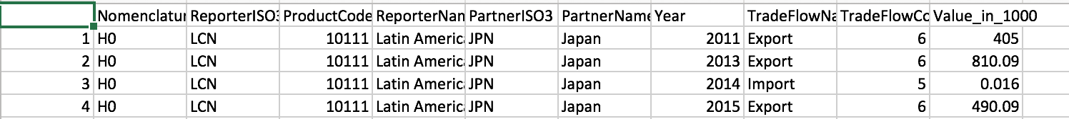
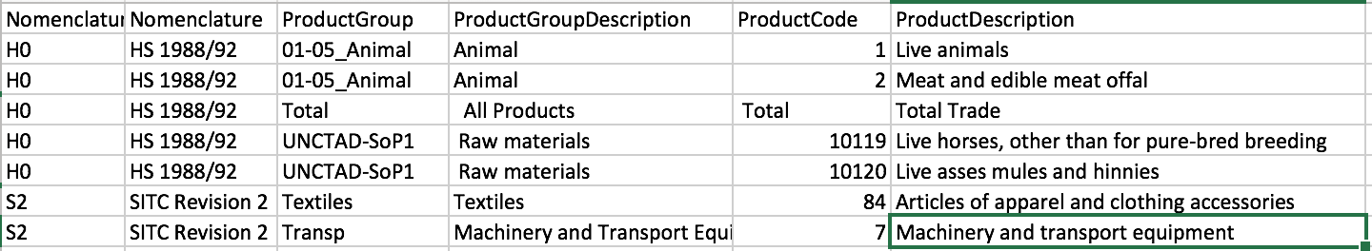
About the Data

Slide 5
Data Cleaning
Mismatched information
Information from an unrelated system
Different measurements coded in the same column
Reformatting
H6 product code
Recoding
Product code -- “Others”
Country income group
Star schema and foreign keys
Notes:
I’ve added some hints for slides 1-3, will leave your part completely for yourself--Yuebo

Slide 6
Data Schema
Product
Id (SK)
productgroupdes
Productcode (NK)
productdes
h2_productcode
h2_category
h2_descriptor
Trade
Id （SK)
Productcode (FK)
Partneriso3 (FK)
partnername
year
tradeflow
tradeflowcode
value_in_000
Country
Id (SK)
countryname
Countryiso3 (NK)
longname
incomegroup
region
wto_member
Foreign Key
Foreign Key

Slide 7
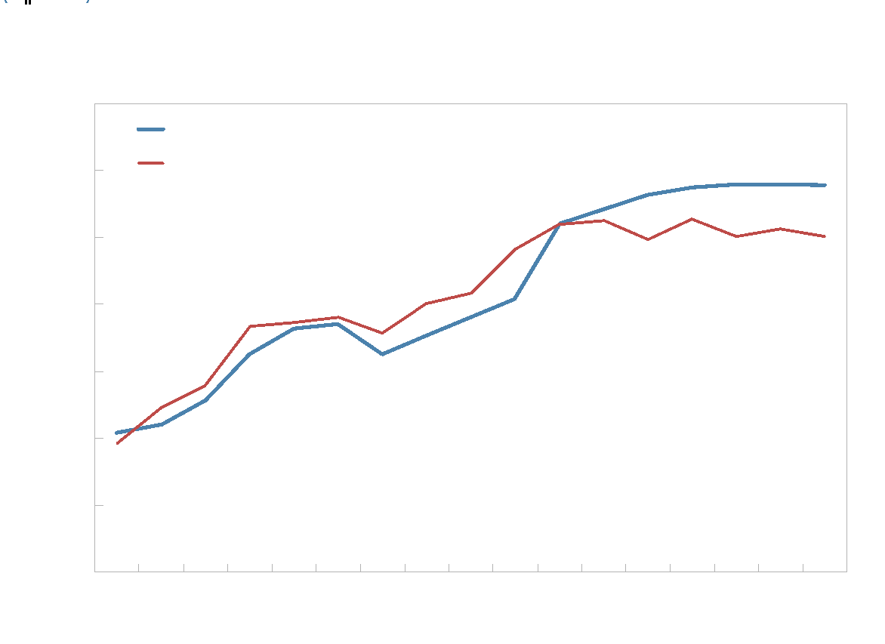
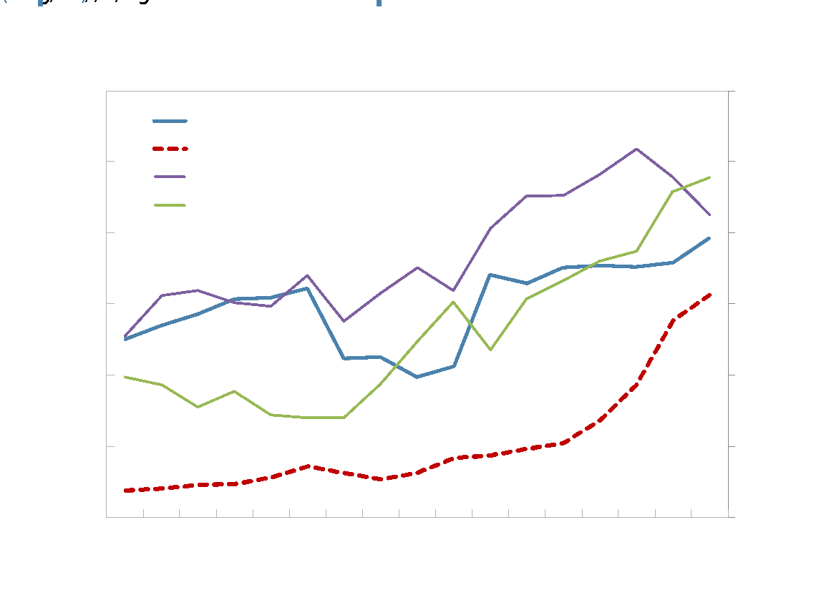
Analysis – Country Level

Slide 8
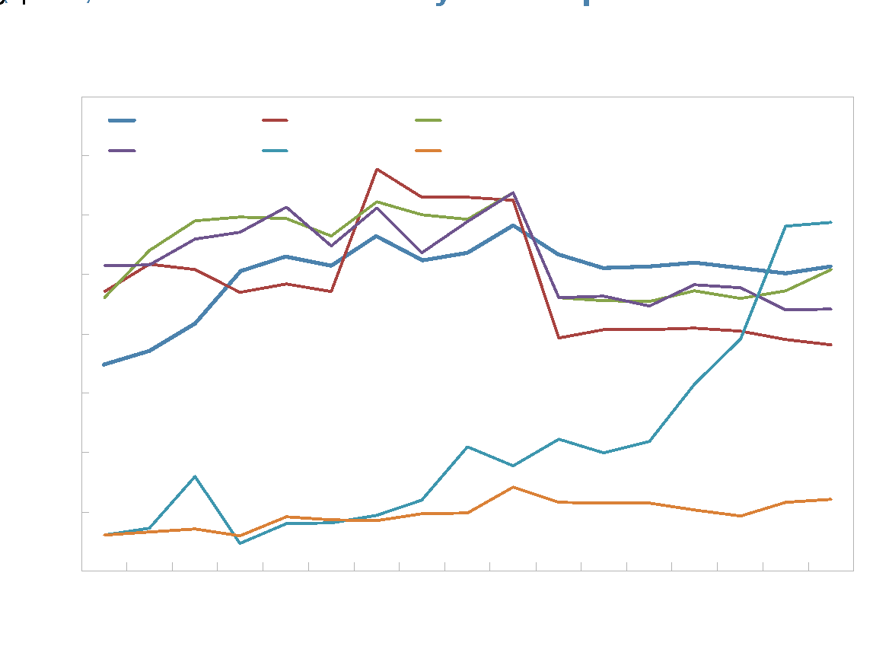
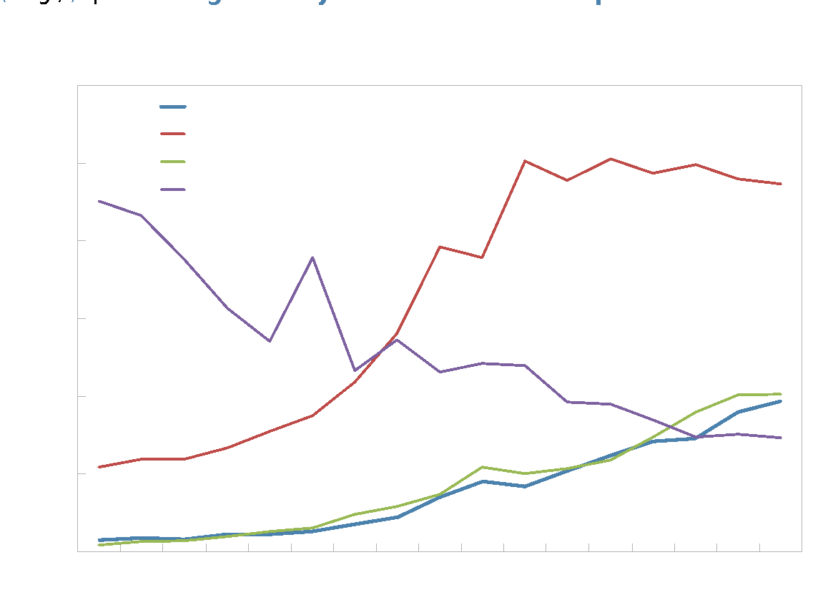
Analysis – Product Level

Slide 9
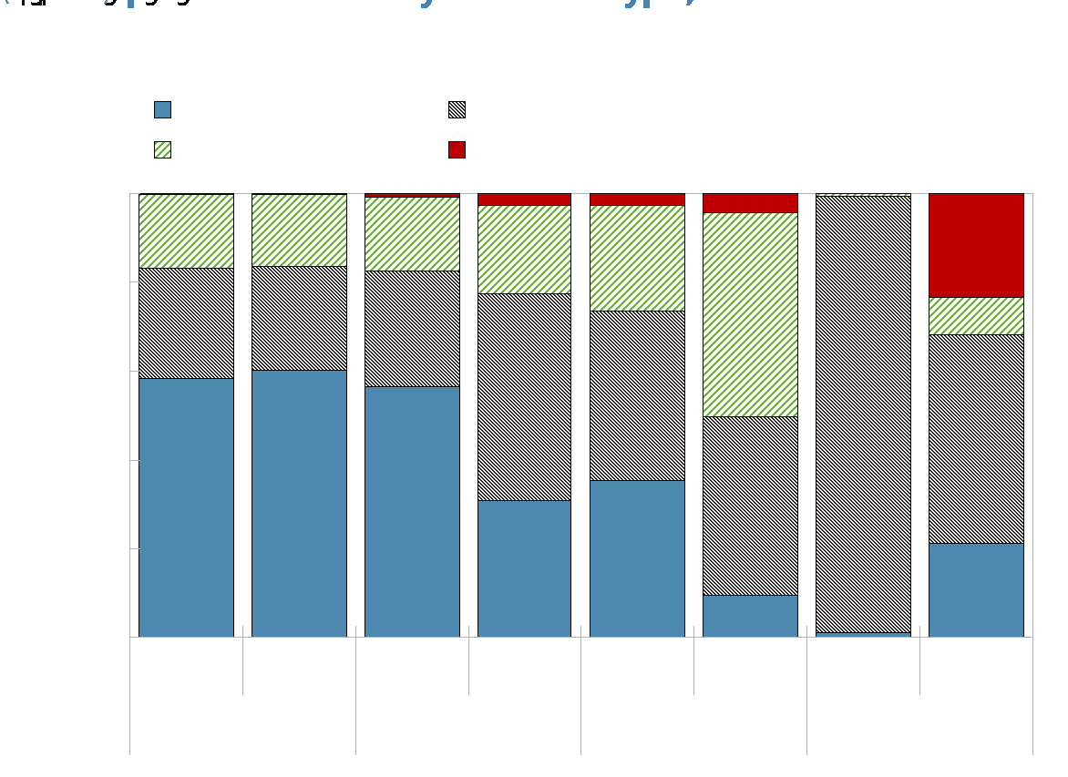
Analysis

Slide 10
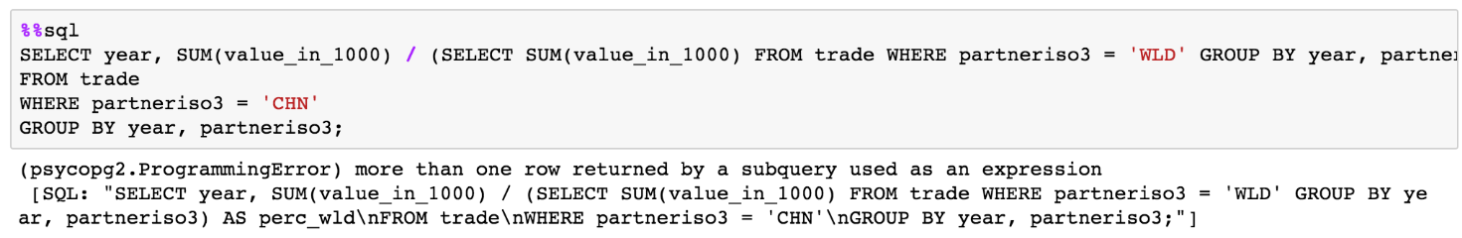
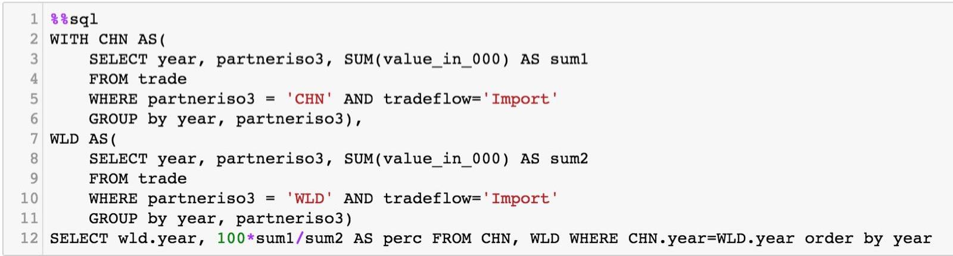
Analysis – On-the-fly Calculations

Slide 11
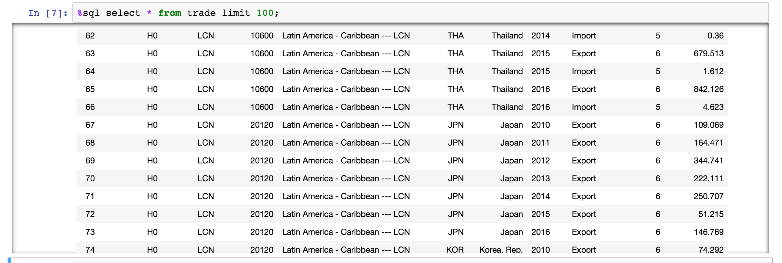
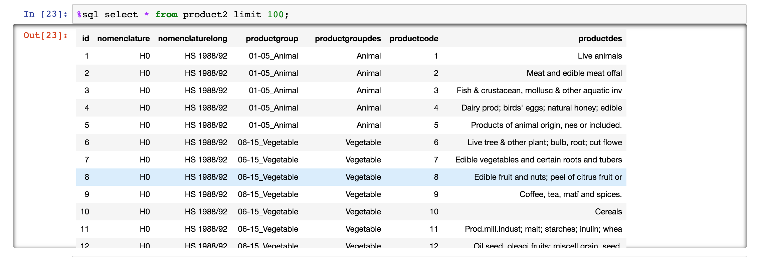
Challenges
Data cleaning: Formatting data (Like zero issues, AA issues, HS2 code with HS6 code, etc)

Slide 12
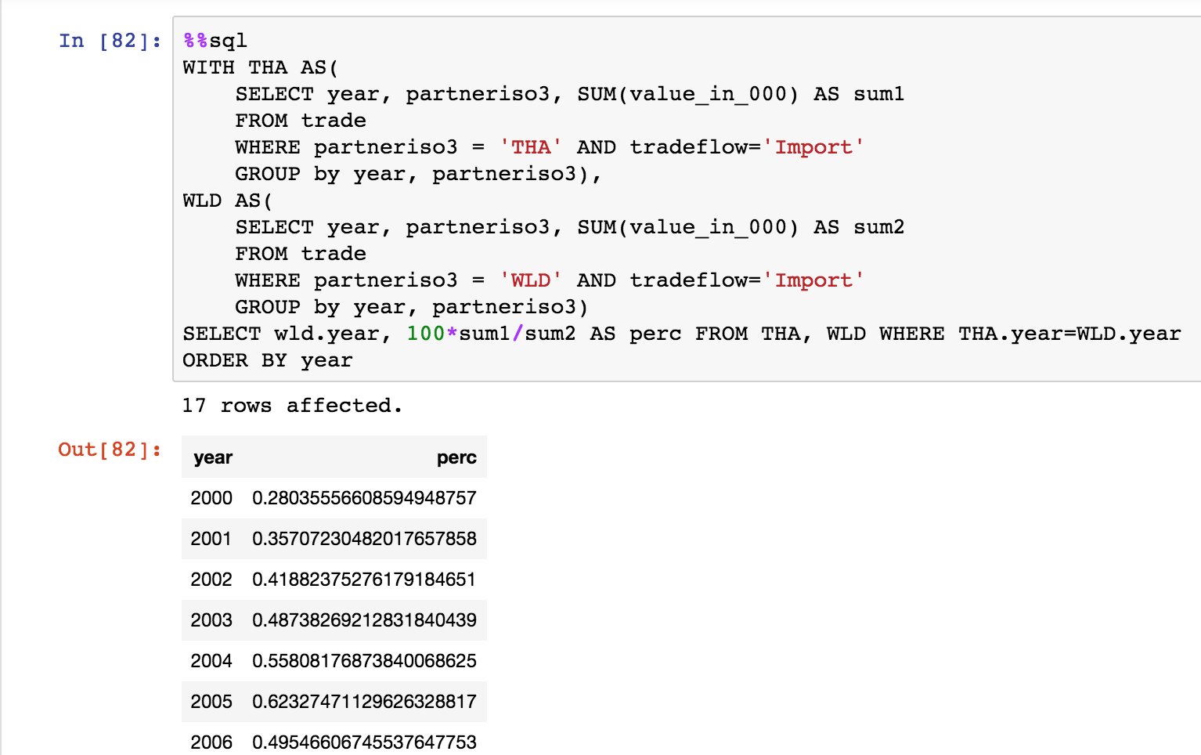
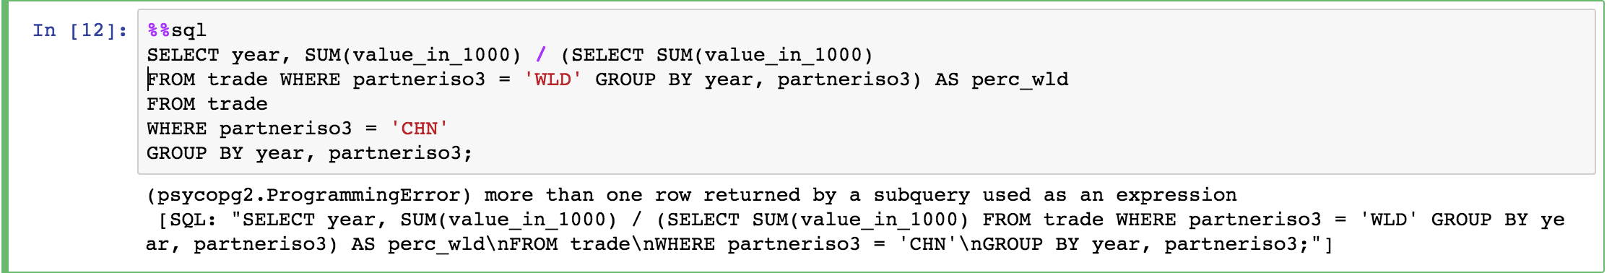
Challenges(Cont.)
Analysis: Calculate the percentage ->How to create a temporary table->WITH statement.

Slide 13
Further to do:
Add GDP data to analyze Im/Ex in percent of GDP;
Add statistical analysis (regression, ANOVA, etc);
Make sure whether zero value is data quality or not……(Missing values or exactly the truth)

